Slide 1
Using Web APIs from R
Oct 11, 2017
Notes:
GLOBAL NOTE When using different layouts for our HCC template:
Please use the bounding area given inside the title and text boxes and DO NOT stretch to make text fit outside area.
This is so we have consistent space around text and keep the margins given for consistent brand throughout.
When applying a new “Layout” make sure you hit the “reset” button to lock the alignment on titles, subtitles and text.
Try to keep text size consistent throughout. If you have a long title, you may have to make part of it as a subtitle to fit.

Slide 2
Best practices for using API
Key features of any API
HTTP request
HTTP response
Steps to R consumes API
Authentication
Pagination (handling multi-page responses)

Slide 3
Key features of any API
HTTP request consists of the following parts:
HTTP method (GET, POST, DELETE, etc.)
The base URL for the API
The URL path or endpoint
URL query arguments (e.g., ?foo=bar)
Optional headers
An optional request body
HTTP response includes:
An HTTP status code.
Headers, key-value pairs.
A body typically consisting of XML, JSON, plain text, HTML, or some kind of binary representation.

Slide 4
Steps to R consumes API
R library support to work with URLs and HTTP
httr - https://cran.r-project.org/web/packages/httr/index.html
Send the request
Web client: curl - https://cran.r-project.org/web/packages/curl/index.html
Parse the response
Parse json: using jsonlite - https://cran.r-project.org/web/packages/jsonlite/index.html
Parse xml: using xml2 - https://cran.r-project.org/web/packages/xml2/index.html
Return the helpful object
Turn API errors into R errors
Set the user agent
Passing parameters

Slide 5
Authentication
Authentication modes:
“Basic” authentication
This requires a username and password (or sometimes just a username)
This is passed as part of the HTTP request
Basic authentication with an API key
This is an API “key” or “token”
This is passed as part of the HTTP request
Better than username/password because it can be regenerated independent of the username and password
OAuth
This is a protocol for generating a user-session authentication token to use in subsequent requests

Slide 6
Pagination
Pagination should be applied when there is a very large number of response data
When a response is paginated, the API response will typically respond with a header or value specified in the body that contains one of the following:
The total number of pages of responses
The total number of response elements (with multiple elements per page)
An indicator for whether any further elements or pages are available
A URL containing the next page

Slide 7
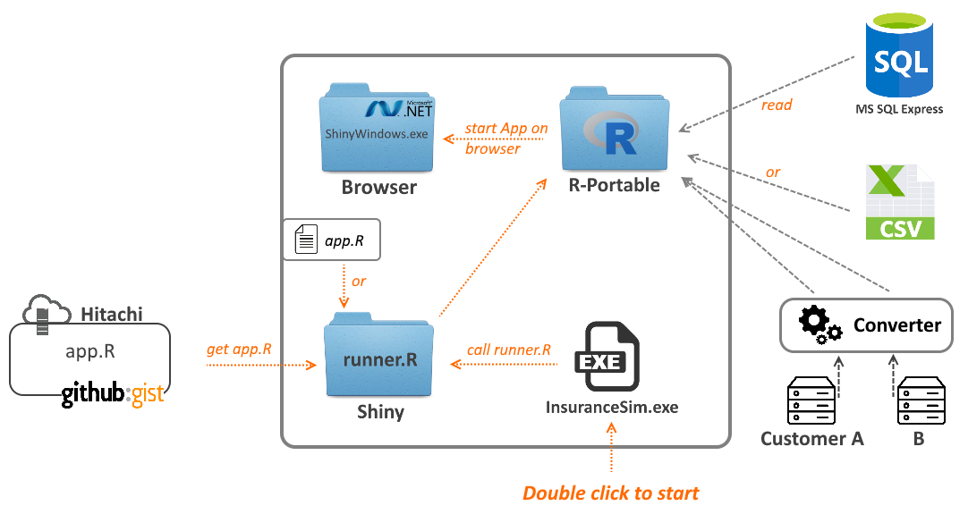
System Architecture Overview

Slide 8
Folder Structure of the package
Folder structure:
+- Application-Folder/
+- Browser/
+- ShinyWindow.exe [An application integrates a [.net] browser]
+- R-portable/ [R-portable folder]
+- Shiny/
+- runner.R [A script installs lib if any, then start app.R on gist.github/local]
+- app.R [Sourcecode of Rshiny app. Locate here on or gist.github]
+- InsuranceSim.exe [Double click this file to start the Rshiny application]

Slide 9
Download and Develop
R-portable:
Download at: https://sourceforge.net/projects/rportable/
Add to the bottom of R-Portable/App/R-Portable/etc/Rprofile.site:
.First = function(){
.libPaths(.Library)
}
Note: This will force R-Portable to only use its local library (specified in the hidden global variable .Library) for installing/loading packages.
.Net framework:
Download at: https://www.microsoft.com/en-us/download/details.aspx?id=55167
Installation is not required from Windows 8.
Refers: https://docs.microsoft.com/en-us/dotnet/framework/get-started/system-requirements

Slide 10
Download and Develop (cont)
app.R:
Add to server.R the function session$onSessionEnded as below
shinyServer(function(input, output, session){
session$onSessionEnded(function() {
stopApp()
})
})
- This function to ensure that it will stop the web socket server started by shiny::runApp() and the underlying R process when the browser window is closed.

Slide 11
Download and Develop (cont)
ShinyWindow.exe:
This is a Window form application which is integrated a .net browser.
Configured with default url: http://127.0.0.1:8888
InsuranceSim.exe:
A console application which performs:
Create Wscript.Shell and run R.exe from R-portable
Setting lib paths to R-portable folder
Start shiny app local: shiny::runApp("./Shiny/",port=8888,launch.browser=TRUE)
or shiny app on gist: shiny::runGist([GISTID],port=8888,launch.browser=TRUE)

Slide 12
Thank you

